Slide 1
G 8 - CT216
LDPC DECODING
FOR 5G NR
Lab Group 2
Under Guidance of : Professor Yash Vasavada
Teaching Assistant Mentor: Vivek Patel

Slide 2
Honor Code
We declare that:
The work that we are presenting is our own work.
We have not copied the work (the code, the results, etc.) that someone else has done.
Concepts, understanding and insights we will be describing are our own.
We make this pledge truthfully.
We know that violation of this solemn pledge can carry grave consequences.

Slide 3


1
2
3
Introduction to LDPC and 5G NR
Encoding
Hard Decision Decoding
4
5
6
Soft Decision Decoding
Results
Conclusion

Slide 4
Initialize Base Graph (BG1/BG2)
Program Flow
Modulate via BPSK
Construct Expanded H Matrix
Generate Input Data Block
Apply LDPC Rules to Encode Data
Receive Noisy Signal
Belief Propagation (Soft Decoding)
Output Decoded
Data block
Bit Thresholding (Hard Decoding)
Program Flow
Output Signal - s

Slide 5
What are LDPC Codes?
Low-Density Parity-Check (LDPC) codes are linear error-correcting codes introduced by Robert Gallager in the 1960s. They are defined by a sparse parity-check matrix (H matrix), which makes encoding and decoding computationally efficient.
LDPC codes are especially suited for modern communication systems like 5G NR, offering minimal latency, low decoding complexity, and very low error rates. Their adaptability to various block sizes and code rates stems from the use of rate-compatible base graphs in their design.
LDPC codes use parity-check matrices that can be regular or irregular. In regular LDPC codes, each row and column has the same number of ones, making them simpler but less flexible. Irregular LDPC codes allow varying numbers of ones in rows and columns, leading to better error correction performance, especially in modern systems. Though more complex to design, irregular codes are preferred in practice due to their efficiency near channel capacity.
What are LDPC Codes?

Slide 6
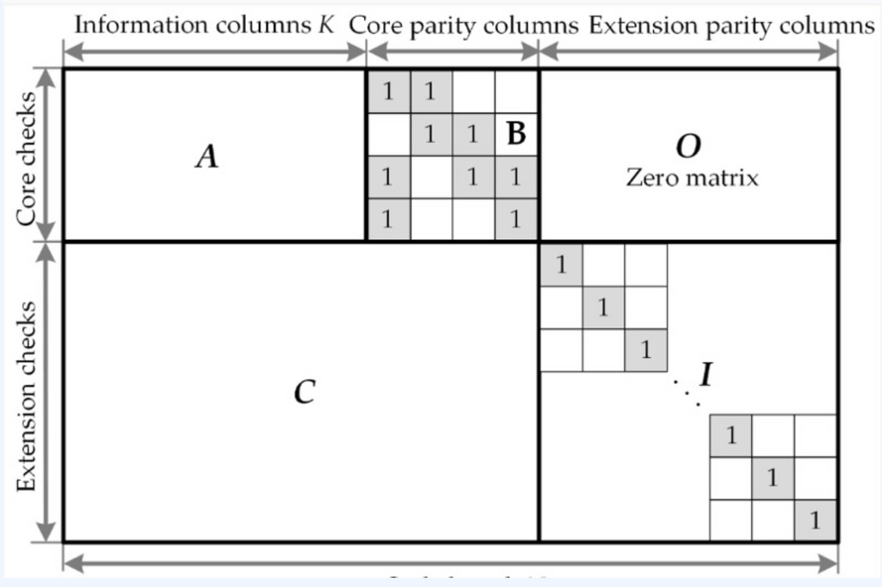
Base Graph Matrix
A- Information Matrix
B- Double Diagonal Matrix
C- Less Dense Matrix
I- All Zero Diagonal Entries
O- All -1's Zero Matrices
Base Graph Matrix

Slide 7
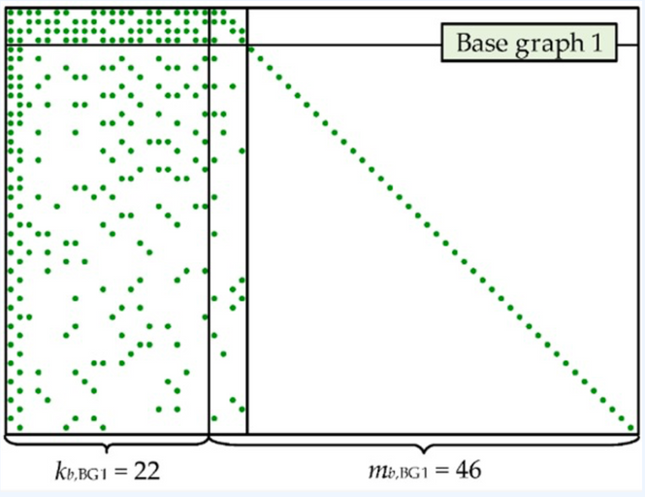
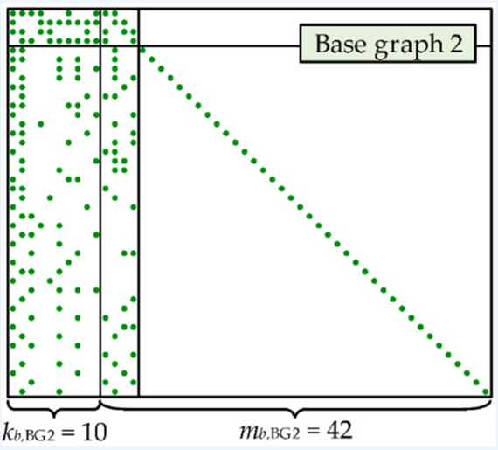
Base Graph Matrix
5G NR uses two base graphs for LDPC coding: BG1 (46×68) and BG2 (42×52), selected based on message size and code rate.
These graphs support up to 22z (BG1) and 10z (BG2) message bits, with a structured base matrix containing values like 0, -1, and numbers up to Z−1, where Z is the expansion factor.
The dual-graph design allows efficient adaptation to different data sizes and ensures reliable communication in diverse 5G scenarios.
(BG1): matrix size of 46x68
Base Graph Matrix
(BG2): matrix size of 42x52

Slide 8
H Matrix
To construct the parity check matrix H from the base graph B, we use an expansion factor z (also called the lifting size). This factor varies based on the base graph.
The construction rules are:
If Bᵢⱼ = -1, replace it with a z × z all-zero matrix.
If Bᵢⱼ = 0, replace it with a z × z identity matrix.
If Bᵢⱼ is between 1 and z−1, replace it with a z × z identity matrix circularly shifted to the right Bᵢⱼ times.
H Matrix

Slide 9
H Matrix
1 0 0 0 0 0 1 0 0 0 0 0 0 0 0 0 0 0 1 0
0 1 0 0 0 0 0 1 0 0 0 0 0 0 0 0 0 0 0 1
0 0 1 0 0 0 0 0 1 0 0 0 0 0 0 1 0 0 0 0
0 0 0 1 0 0 0 0 0 1 0 0 0 0 0 0 1 0 0 0
0 0 0 0 1 1 0 0 0 0 0 0 0 0 0 0 0 1 0 0
0 0 1 0 0 0 0 0 0 0 0 0 0 0 1 1 0 0 0 0
0 0 0 1 0 0 0 0 0 0 1 0 0 0 0 0 1 0 0 0
0 0 0 0 1 0 0 0 0 0 0 1 0 0 0 0 0 1 0 0
1 0 0 0 0 0 0 0 0 0 0 0 1 0 0 0 0 0 1 0
0 1 0 0 0 0 0 0 0 0 0 0 0 1 0 0 0 0 0 1
0 0 0 0 0 0 0 1 0 0 0 0 0 1 0 0 1 0 0 0
0 0 0 0 0 0 0 0 1 0 0 0 0 0 1 0 0 1 0 0
0 0 0 0 0 0 0 0 0 1 1 0 0 0 0 0 0 0 1 0
0 0 0 0 0 1 0 0 0 0 0 1 0 0 0 0 0 0 0 1
0 0 0 0 0 0 1 0 0 0 0 0 1 0 0 1 0 0 0 0
Base Matrix, B = [
0 1 -1 3;
2 -1 4 0;
-1 2 3 1
];
Expansion Factor, Z = 5;
Parity Matrix, H =
H Matrix

Slide 10
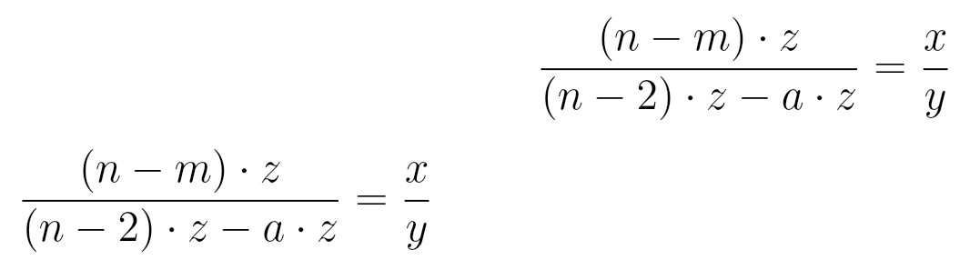
Coderate matching
(Puncturing)
Rate matching is used in LDPC codes to adjust the code rate to match the desired transmission rate. For a base matrix of size m × n and expansion factor z, the possible length of the codeword is n-z. Out of these n-z bits, the first 2z bits are punctured, leaving (n−2)·z bits available.
To achieve a code rate of x/y, a·z bits are punctured from the available (n−2)·z bits. The number of message bits is calculated as (n−m)·z.
The H matrix size is determined by the number of parity bits (calculated from the equation) and columns (calculated number + 2).
Coderate Matching(Puncturing)

Slide 11
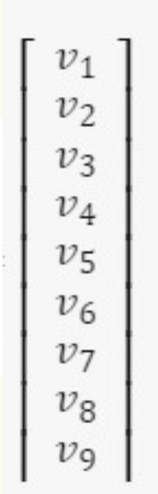
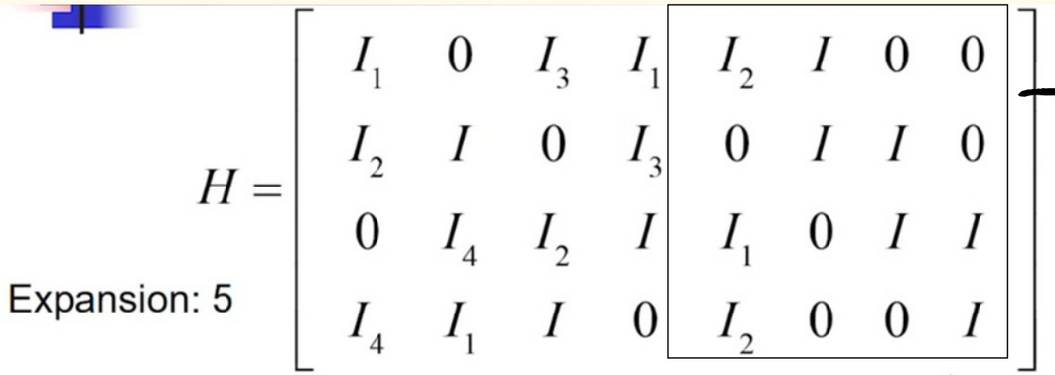
Encoding
The base matrix is given as follows:
Encoding
Ik shows the 5 x 5 identity matrix
right shifted k times.
0 represents a 5 x 5 all zeros

Slide 12
Encoding
Equations and Encoding Process:
Equations obtained:
( l₁v₁ + l₃v₃ + l₄v₄ + l₅v₅ + l₆v₆ = 0 ) (Equation 1)
( l₂v₂ + l₄v₄ + l₆v₆ + l₇v₇ = 0 ) (Equation 2)
( l₄v₄ + l₅v₅ + l₆v₆ + l₇v₇ = 0 ) (Equation 3)
( l₁v₁ + l₂v₂ + l₇v₇ + l₈v₈ = 0 ) (Equation 4)
Combining the equations:
( l₁v₅ = l₁v₁ + l₁v₄ + l₁v₂ + l₁v₃ + l₁v₅ + l₃v₃ + l₄v₄ + l₅v₅ + l₆v₆ + l₄v₄ )
Message structure:
[( v₁, v₂, v₃, v₄, v₅, v₆, v₇, v₈, v₉ )] = [( m₁, m₂, m₃, m₄, m₅, p₁, p₂, p₃, p₄ )]
Encoding

Slide 13
Encoding
Rewriting the parity bit equation:
( l₁p₁ = l₁m₁ + l₃m₁ + l₄m₁ + l₁m₂ + l₄m₂ + l₁m₃ + l₃m₃ + l₁m₄ + l₃m₄ + l₄m₄ )
Solving for parity bits:
First, solve for ( p₁ ) using the rewritten equation.
Substitute ( p₁ ) into Equation 1 to find ( p₂ ).
Continue solving to determine ( p₃ ) and ( p₄ ).
Encoded message verification:
The encoded message must satisfy the equality ( H*c = 0 ).
Encoding

Slide 14
BPSK Modulation
The encoded output is passed to a BPSK modulator, which converts the matrix of encoded bits to the matrix of encoded symbols (1, -1). Specifically:
1 becomes -1
0 becomes 1
This process enables efficient transmission of the encoded message over a communication channel.
BPSK (Binary Phase Shift Keying) is a modulation technique used in LDPC encoding to represent binary data as symbols (1, -1). It is fundamental in ensuring that the encoded data, which consists of binary values, can be transmitted efficiently over noisy channels, where the reliability of error correction codes like LDPC becomes essential.
The encoded symbols are transmitted through an AWGN (Additive White Gaussian Noise) channel, which introduces noise into the system. The variance of the noise added is given by the formula:
BPSK Modulation

Slide 15
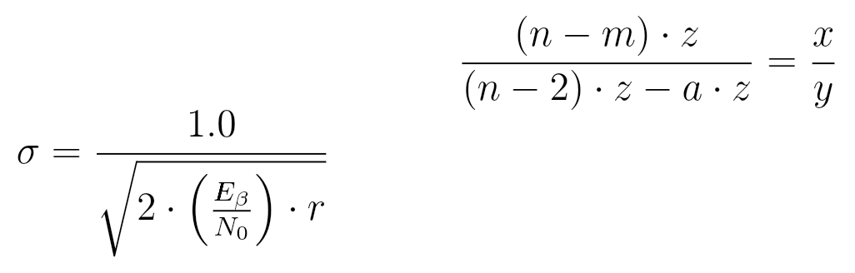
BPSK Modulation
is the energy per bit.
is the noise power spectral density.
is code rate
is the result of the calculation.
BPSK Modulation

Slide 16
AWGN
Definition: AWGN stands for Additive White Gaussian Noise:
Additive: Noise is added to the transmitted signal (or bit).
White: The noise follows a Gaussian distribution, meaning its values are spread in a predictable way, with a mean of zero.
Application: In practical systems, AWGN is added to each transmitted bit. For example:
If a bit is 1 and a noise value of 0.4 is added, the result is 1.4.
Monte Carlo simulations are often used to simulate real-world conditions, running multiple iterations (e.g., 1,000) to ensure that the noise values are randomly applied to the matrices, so no two matrices have identical noise patterns.
Integration in Programs: AWGN is commonly integrated into simulation tools using functions like random.randn(), which generates random values with a normal (Gaussian) distribution.
AWGN

Slide 17
Hard Decoding
Hard decision decoding uses binary values (0 or 1) derived from the received signal and operates on the Tanner graph using iterative message passing. This approach is based purely on logic (XOR, majority voting), making it computationally efficient but less optimal than soft decision decoding
The algorithm follows an iterative message passing process on the Tanner graph, where:
Variable Nodes (VNs) represent bits of the codeword.
Check Nodes (CNs) represent the parity constraints.
Each iteration consists of the following 3 major steps:
1.VN → CN Message Passing (Initialization & Updates)
2.CN → VN Message Passing (Parity Check Updates)
3.Bit Decision (Computing ĉ)
Decoding

Slide 18
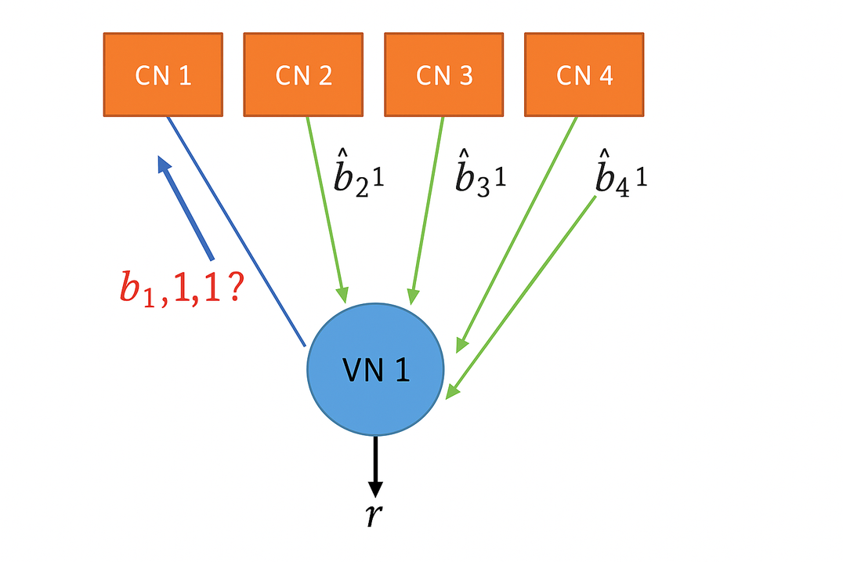
Hard Decoding
1.VN → CN Message Passing (Initialization & Updates)
First Iteration:
Each Variable Node (VN) sends the received hard value (from channel) to all its connected Check Nodes(CNs).
Subsequent Iterations:
A VN computes the majority of all messages it has received from connected CNs (except the CN it's sending to).
This avoids message loops and provides extrinsic information.
The VN then sends the result of the majority voting to that CN.
Decoding

Slide 19
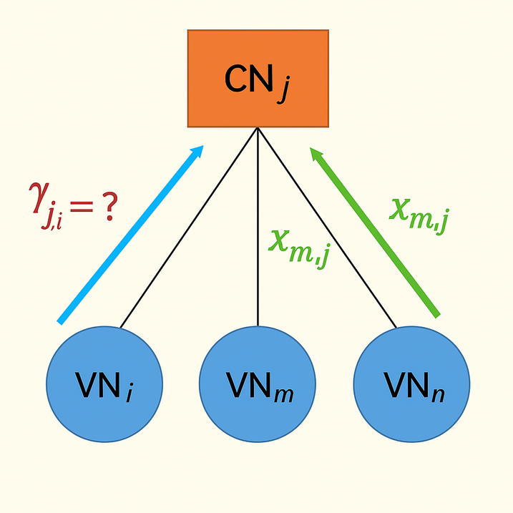
Hard Decoding
2.CN → VN Message Passing (Parity Check Updates)
Each Check Node implements a Single Parity Check (SPC).
It receives values from all connected VNs.
To send a message back to a VN, the CN:
Computes the XOR of all incoming bits except the one from the target VN.
Sends this XOR result back as its belief about the target VN's bit.
Decoding

Slide 20
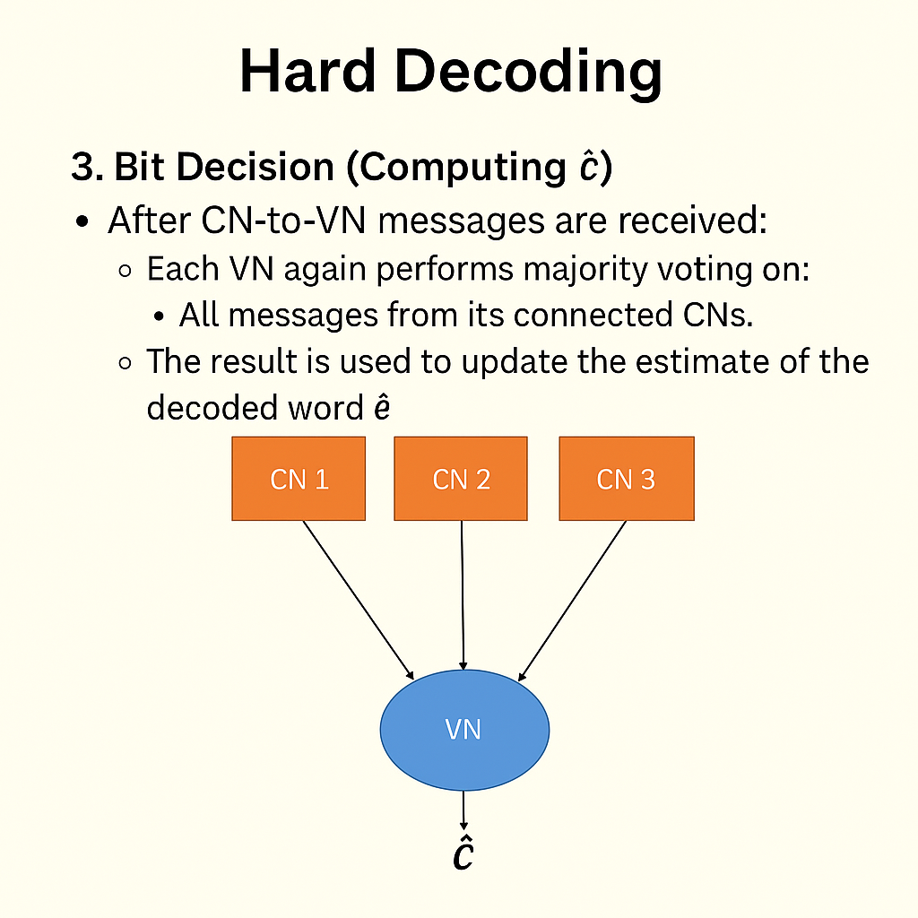
Hard Decoding
3.Bit Decision (Computing ĉ)
After CN-to-VN messages are received:
Each VN again performs majority voting on:
All messages from its connected CNs.
, Its originally received bit.
The result is used to update the estimate of the decoded word ĉ
Decoding

Slide 21
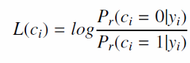
Soft Decision Decoding
Minimum Sum Approximation Algorithm (Min-Sum):
Soft decision decoding uses real valued inputs i.e. LLRs instead of binary decisions to improve decoding accuracy.
The LLRs are received in decoder and are calculated as:
The log-likelihood ratio (LLR), gives us a measure of how likely the next received bit is to be a 0 or a 1. To estimate this using the Min-Sum Approximation, we start with the sum-product algorithm. This algorithm involves applying the inverse hyperbolic tangent (tanh⁻¹) function to the product of individual LLRs across bits, iterating over n values. The result is a sum that reflects the combined probabilities of these bits. Since tanh⁻¹ can be expressed as a log function, it simplifies the computation. The min-sum approximation then comes in to further refine this output, using an approximation technique to simplify the results while maintaining accuracy.
Decoding

Slide 22
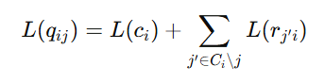
Soft Decision Decoding
Minimum Sum Approximation Algorithm (Min-Sum):
VN → CN Updates after first iteration.
Here, after a CN sends a message to VN, each VN then calculates the next message which it will pass to every connected CN which is computed using the following expression:
This process continues iteratively, refining estimates.
Decoding

Slide 23
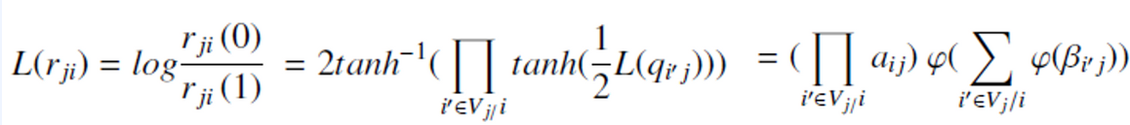
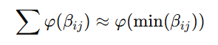
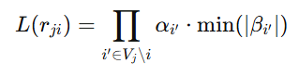
Soft Decision Decoding
Minimum Sum Approximation Algorithm (Min-Sum):
VN → CN Transmission:
Each VN sends messages to connected CNs using the formula:
Here the main problem would be that computing tanh would be much complex and this is where Min-Sum Approximation helps us.
The sum of φ-values can be approximated by the smallest φ-value:
Message from CN to VN then becomes:
Decoding

Slide 24
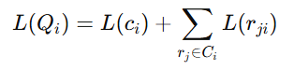
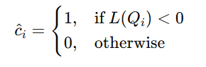
Soft Decision Decoding
Minimum Sum Approximation Algorithm (Min-Sum):
Final Bit Decisions
After each round of message passing between the VNs and CNs, we update our best guess for each bit. This is done by combining all the incoming messages to each variable node, giving us the most up-to-date belief about its value.
To compute this, we define total LLR for bit Ci as:
This total LLR value gives us an updated estimate of likelihood that bit Ci is 0 or 1.
Using this we make a hard decision for as follows for each bit:
Decoding

Slide 25
Soft Decision Decoding
Minimum Sum Approximation Algorithm (Min-Sum):
Final Bit Decisions (continue)
This total LLR value gives us an updated estimate of likelihood that bit Ci is 0 or 1.
Using this we make a hard decision for as follows for each bit:
Here,
→ If the total LLR is -ve → the bit is more likely to be 1.
→ If the total LLR is 0(zero) or +ve → the bit is assumed to be 0.
The decoding stops when:
→ The maximum number of iterations has been reached
→ The estimated codeword Ĉ satisfies the parity-check condition i.e. H⋅ Ĉ = 0 meaning it’s a valid codeword according to the code’s structure.
Decoding

Slide 26
Soft Decision Decoding
Step-by-Step Implementation
To implement the soft decision decoding algorithm, we start by using the parity check matrix H, where each row corresponds to a CN and each column to a VN. A value of 1 at position (i, j) in the matrix indicates a connection between CN i and VN j. Using this structure, we generate a new matrix called L, where every 1 in the H matrix is replaced with the received LLR, effectively initializing each variable node with the observed values from the channel.
Once the L matrix is formed, we begin message passing between CNs and VNs. This is done by applying the Min-Sum Approximation: for each row in L, we replace each non-zero entry with the minimum of the other non-zero values in the same row, and adjust the sign based on the product of signs. After this CN to VN step, we update messages from VNs to CNs by summing values in each column of the L matrix.
The updated values give us the new LLRs, which help in estimating the most likely decoded bits Ĉ. To check if decoding is complete, we compute the matrix product H x Ĉ if the result is zero or we've hit the iteration limit, the process stops, otherwise it continues.
Decoding

Slide 27
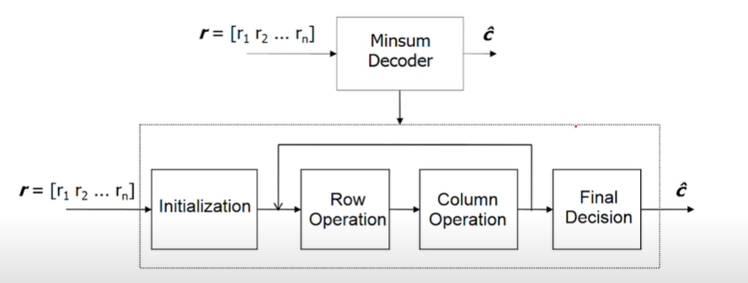
Example for better Understanding
Min Sum decoder

Slide 28
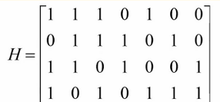
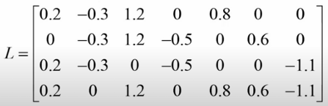
Example for better Understanding
Suppose we have the H matrix as
received vector is :
We make the L matrix as :

Slide 29
Example for better Understanding
For each row,
Magnitude
Min1 = minimum absolute value of all nonzero entries in row
Min2 = next higher absolute value
Set magnitude of all values (except minimum) = Min1
Set magnitude of minimum value = Min2
Sign
Parity = product of signs of entries in row
New sign of an entry = (Old Sign) × (Parity)

Slide 30
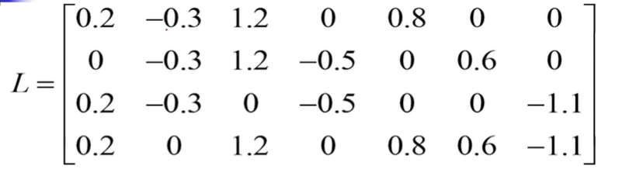
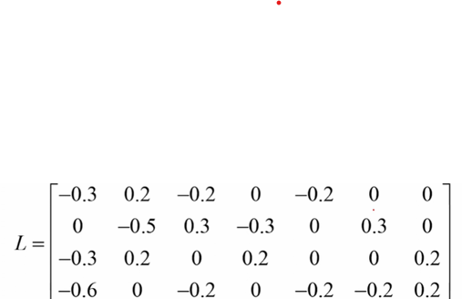
Example for better Understanding
Before row operation
After row operation

Slide 31
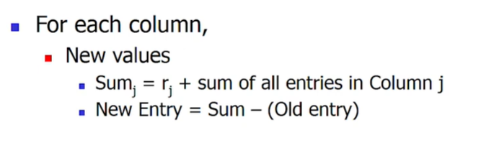
Example for better Understanding

Slide 32
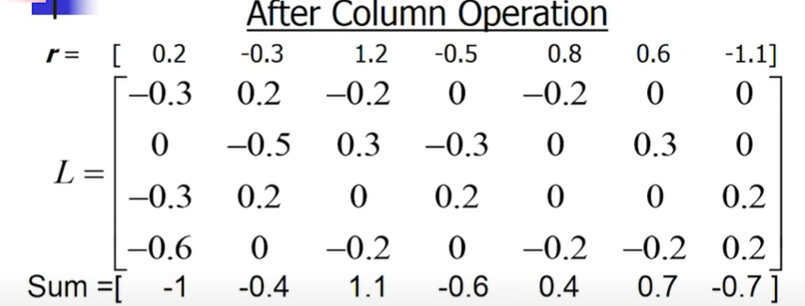
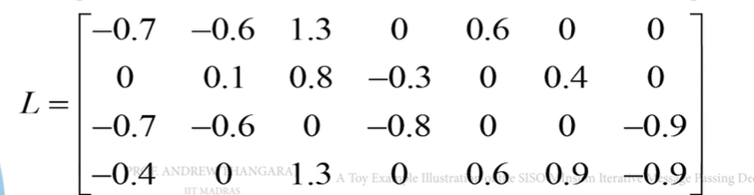
Example for better Understanding
The updated beleif after 1st iteration:
The updated L matrix is:
We then convert the new vector sum to 0s and 1s and compare it with original message to check if it is decoded successfully. This continues in a loop.

Slide 33
RESULTS OF MATRIX NR_2_6_52

Slide 34
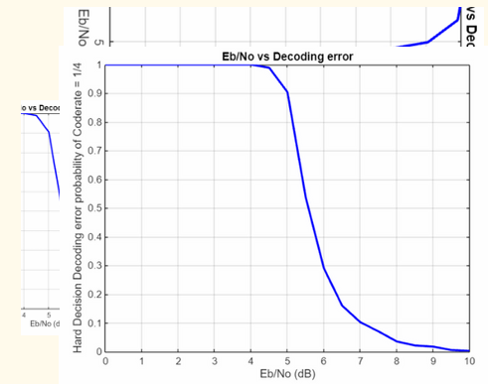
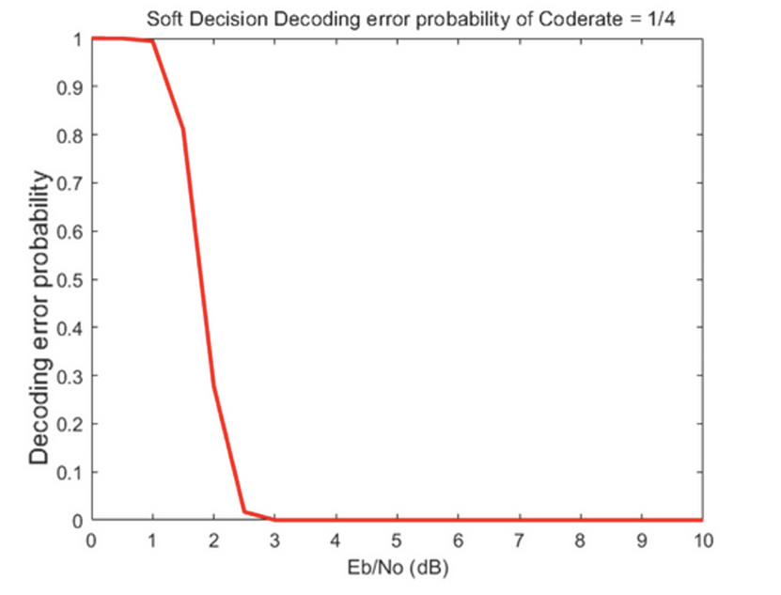
CODE RATE = 1/4
HARD DECISION DECODING
SOFT DECISION DECODING

Slide 35
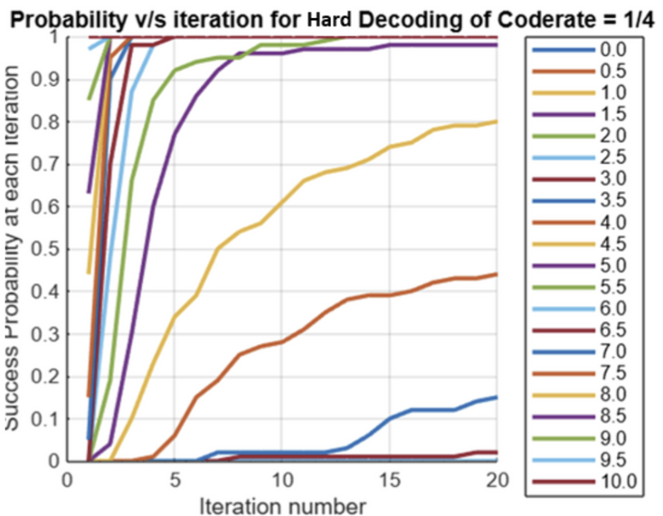
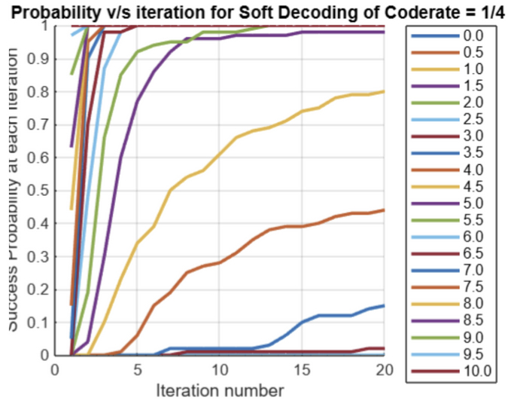
CODE RATE = 1/4
HARD DECISION DECODING
SOFT DECISION DECODING

Slide 36
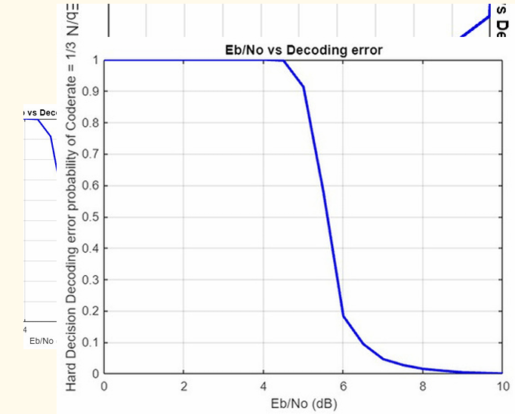
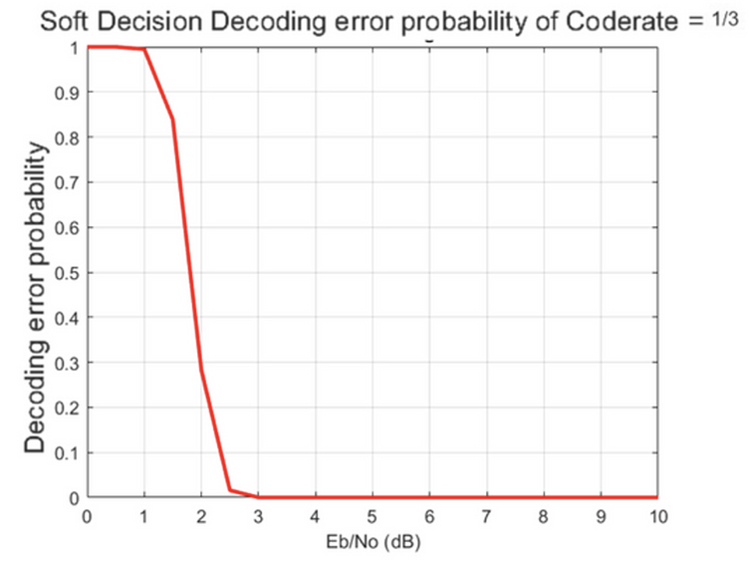
CODE RATE = 1/3
HARD DECISION DECODING
SOFT DECISION DECODING

Slide 37
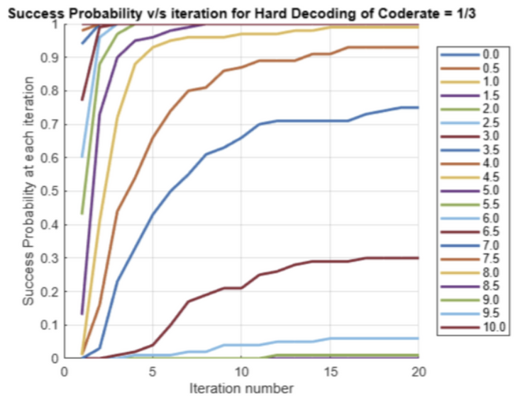
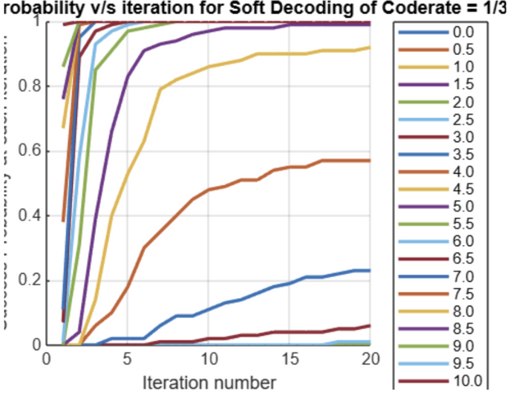
CODE RATE = 1/3
HARD DECISION DECODING
SOFT DECISION DECODING

Slide 38
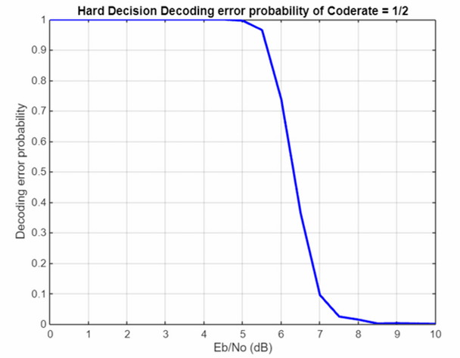
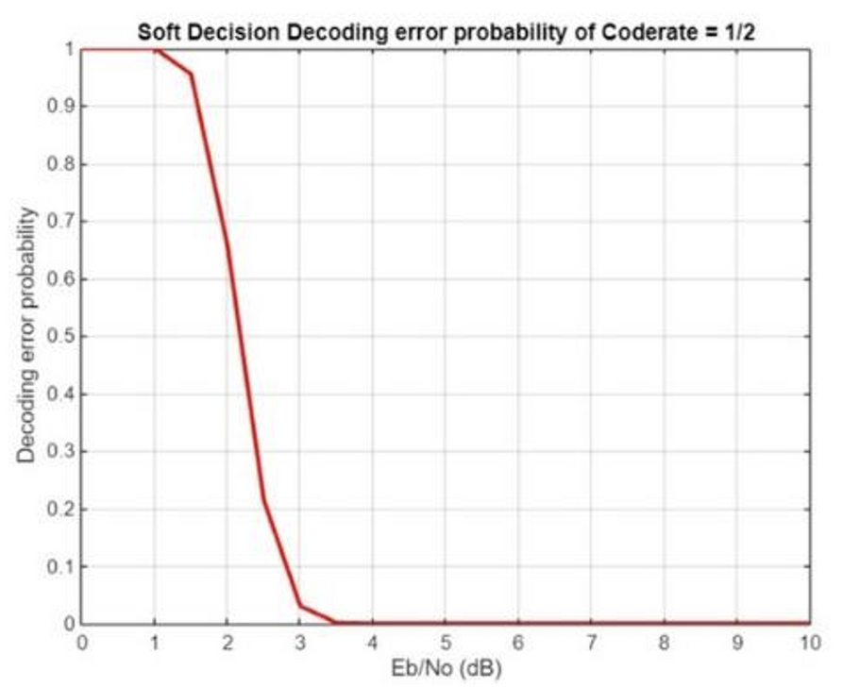
CODE RATE = 1/2
HARD DECISION DECODING
SOFT DECISION DECODING

Slide 39
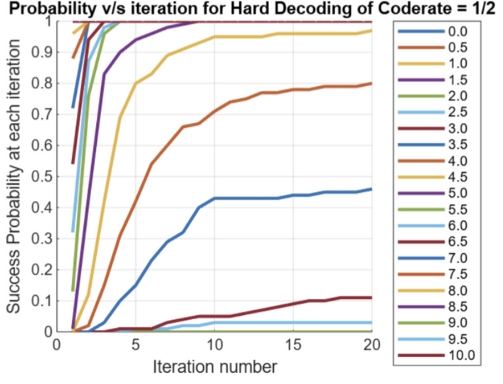
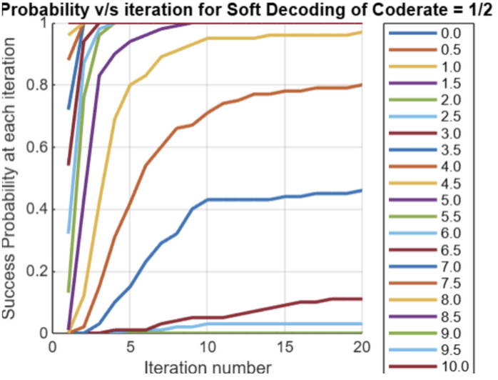
CODE RATE = 1/2
HARD DECISION DECODING
SOFT DECISION DECODING

Slide 40
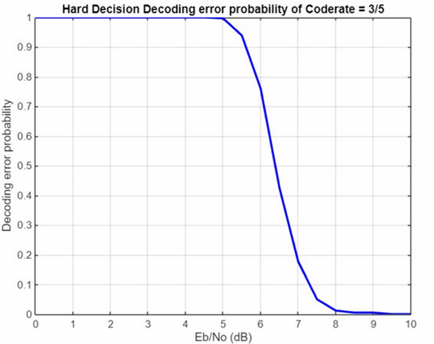
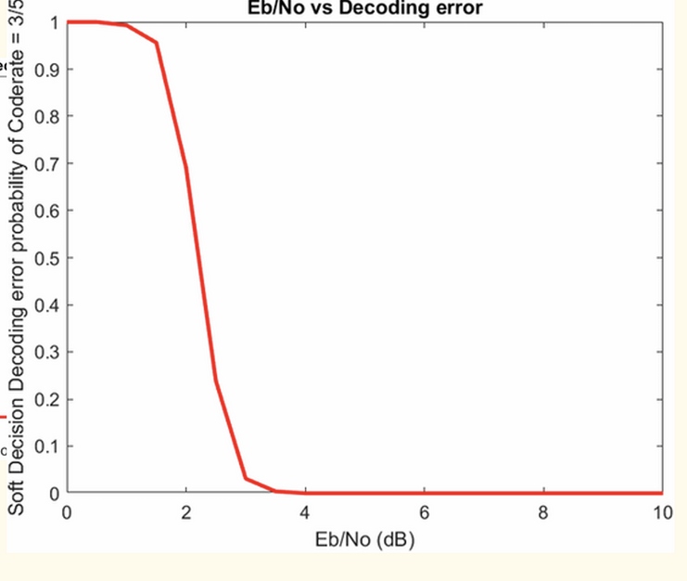
CODE RATE = 3/5
HARD DECISION DECODING
SOFT DECISION DECODING

Slide 41
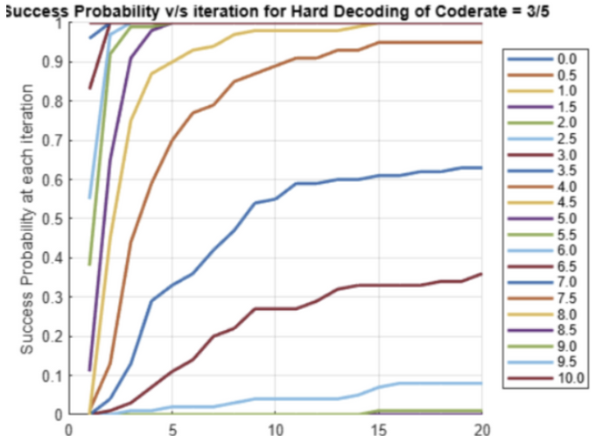
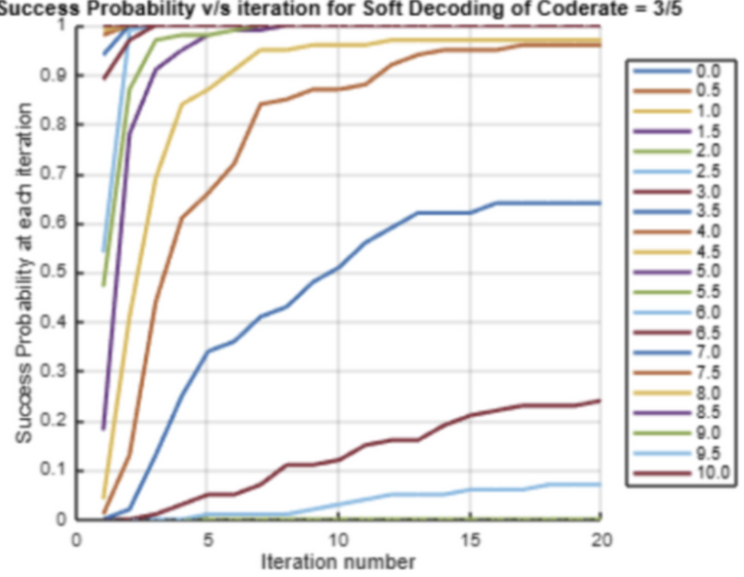
CODE RATE = 3/5
HARD DECISION DECODING
SOFT DECISION DECODING

Slide 42
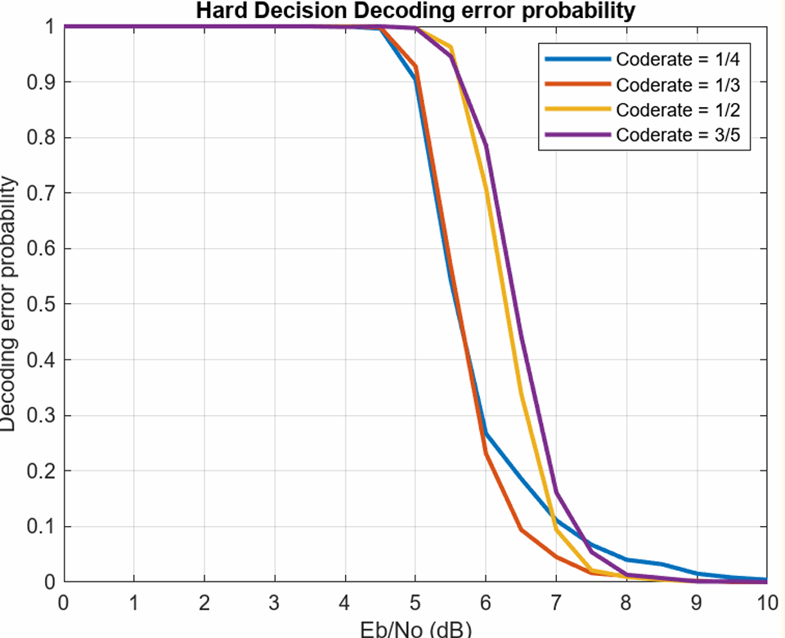
HARD DECISION DECODING

Slide 43
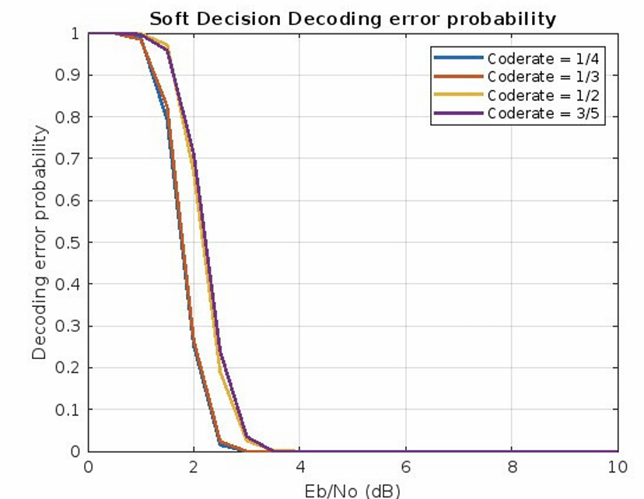
SOFT DECISION DECODING

Slide 44
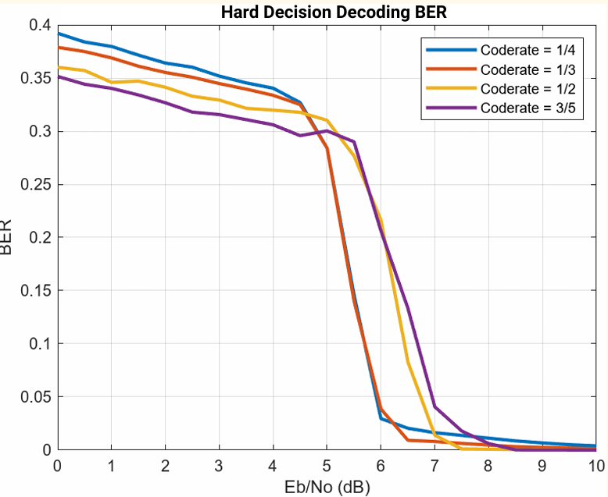
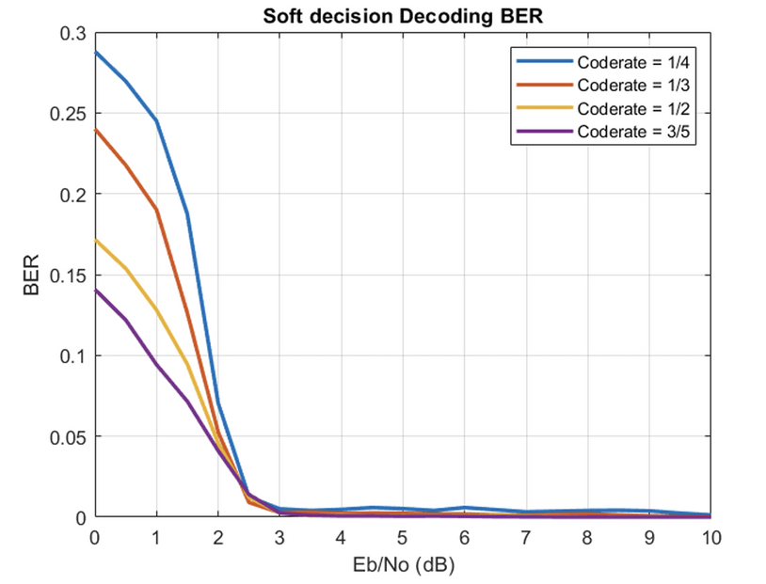
Bit Error Rate
HARD DECISION DECODING
SOFT DECISION DECODING

Slide 45
RESULTS OF MATRIX NR_1_5_352

Slide 46
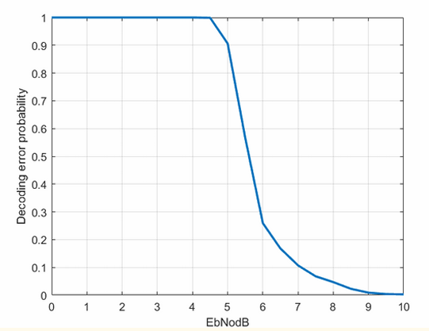
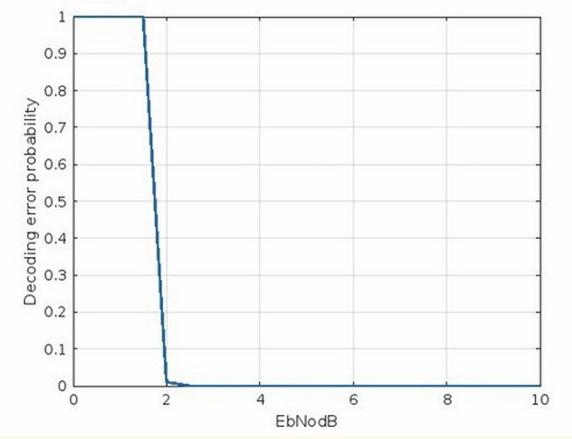
CODE RATE = 1/3
HARD DECISION DECODING
SOFT DECISION DECODING

Slide 47
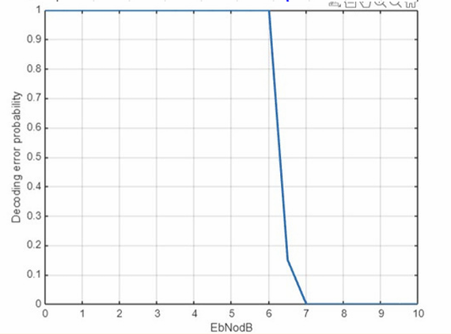
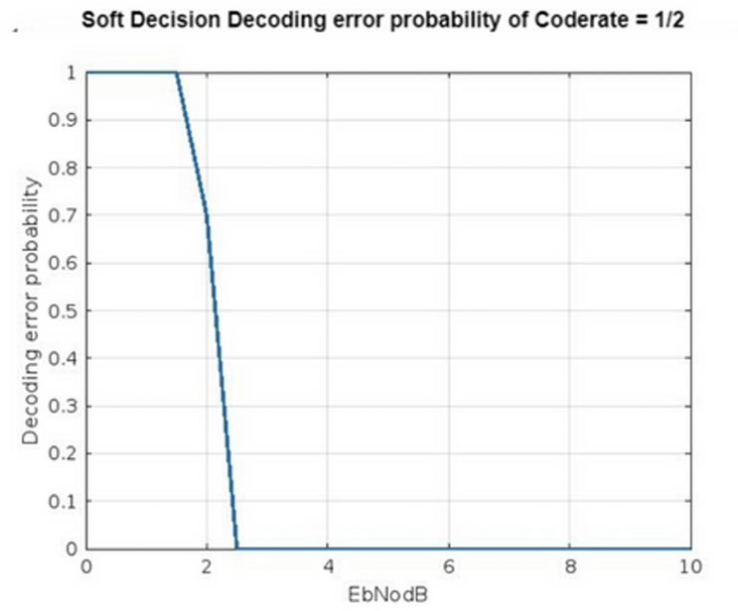
CODE RATE = 1/2
HARD DECISION DECODING
SOFT DECISION DECODING

Slide 48
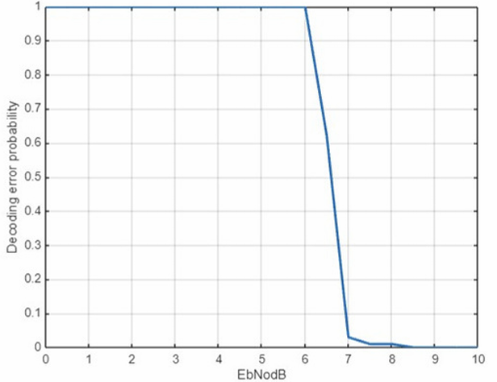

CODE RATE = 3/5
HARD DECISION DECODING
SOFT DECISION DECODING

Slide 49


CODE RATE = 4/5
HARD DECISION DECODING
SOFT DECISION DECODING

Slide 50

SOFT DECISION DECODING

Slide 51

COMPARISON WITH SHANNON

Slide 52
Bibliography
Lecture Slides by Professor Yash Vasavada CT216 - Winter 2025.
Video Lectures of NPTEL-NOM IITM by Prof. Andrew Thangaraj on LDPC codes.
Implementation of Low-Density Parity-Check codes for 5G NR shared channels by LIFANG WAN

Slide 53
Team Members
202301078 KRISH BHAVESHKUMAR PATEL
202301079 KUSHAL BHUPTANI
202301080 HARSHVIR SINGH
202301081 HET RANK
202301082 AAYMAN AMMAR SHAMS
202301083 DHAMELIYA UTSKER ARJANBHAI
202301084 AYUSH PATEL
202301085 KAVYA PARMAR
202301086 RITUL PATEL
202301087 AGRIM SHARMA
202301088 SANTOKI TAPAS ASHOKBHAI

Slide 54










Kavya Parmar
Agrim Sharma
Ritul Patel
Ayush Patel
Tapas
Dhameliya Utsker
Krish Patel
Aayman Ammar Shams
Harshvir Singh
Het Rank

Slide 55
Thank You

